Slide 1


Argo CD
Training for Amdocs

Slide 2

DISCLAIMER
The training content and delivery of this presentation is confidential, and cannot be recorded, or copied and distributed to any third party, without the written consent of Imarticus Learning Pvt. Ltd.

Slide 3

What is Argo CD?
Notes:
After the discussion, ask them to define communication? Then show the next slide

Slide 4

WHAT IS ARGO CD?
ArgoCD is a Kubernetes-native continuous delivery tool. It automates the deployment of applications to Kubernetes clusters. ArgoCD tracks application definitions and configurations in Git repositories.
It ensures the desired state in Git matches the actual state in the cluster. This approach improves consistency, reliability, and transparency in application deployments.
Questions : Why we need separate CD tools, What are the challenges?

Slide 5
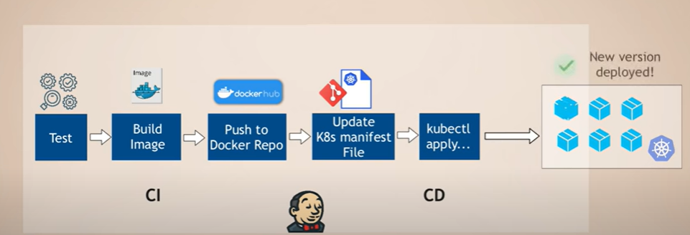
CICD (Continuous Delivery)

Slide 6




Challenges
Install and setup tools , like kubectl need to implement in CICD tool side.
Live monitoring is not possible for deployed components. No further visibility
Need to provide access to CICD tool to control the access, that become one of the security issue. Example provide Kubernetes access in Jenkins to deploy environment
No way to check the health.

Slide 7
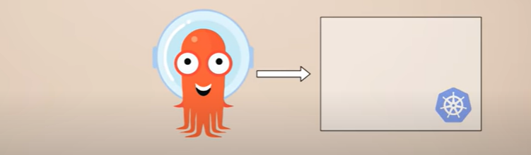
How Argo CD Can Solve The Issue?

Slide 8

Introduction
Notes:
After the discussion, ask them to define communication? Then show the next slide

Slide 9

INTRODUCTION
Argo CD is a pull-based GitOps tool for continual Delivery to Kubernetes Clusters
Argo run inside your Kubernetes cluster and connects to your source repositories.
It automatically detects changes you make Kubernetes resource definition and sync them to the cluster
It automates the process of deploying apps into your cluster by offering a declarative, GitOps-driven configuration process.

Slide 10
INTRODUCTION
Argo uses declarative configuration to understand the desired state of your deployments. The resources in your Git repository declare this state;
Argo then automates the process of adding, altering, and removing Kubernetes cluster objects to achieve it.
Argo can prevent configuration drift by continually resyncing your cluster objects to the configuration declared in your repository, ensuring unintentional changes are quickly reversed.

Slide 11

WHAT IS GITOPS?
GitOps, which uses Git as a foundational element for managing infrastructure and applications, offers a transformative approach by integrating version control and automation into the deployment pipeline.
Single Source of Truth: Git repositories store the desired state of the system, ensuring that configurations and application states are consistent, transparent, and easily auditable.
Automated deployment processes reduce the risk of human error, and the ability to revert to previous states quickly helps maintain stability.

Slide 12
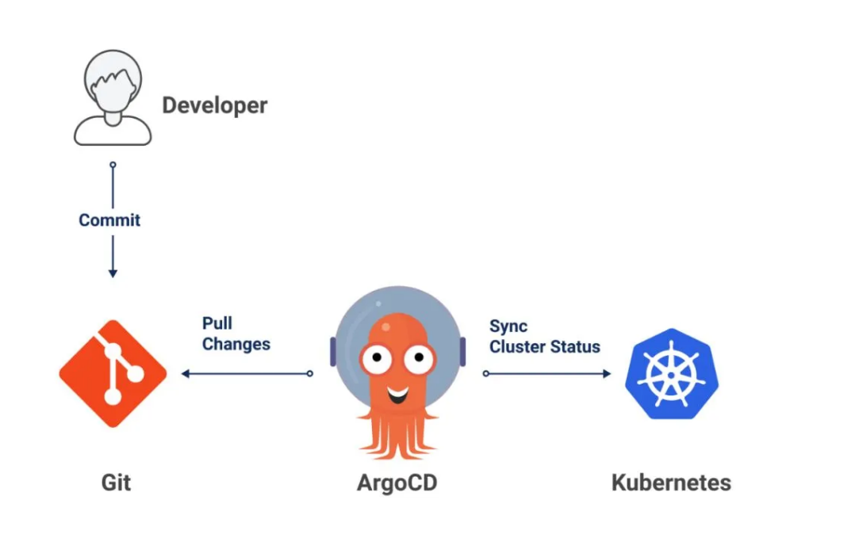
WHAT IS GITOPS?

Slide 13
PRINCIPLES
Declarative Configuration:
All resources are defined declaratively.
Version Control:
System and application states are stored in version control systems, enabling history tracking, rollbacks, and the use of standard Git operations.
Automated Deployment:
Automated tools ensure that the production environment matches the state described in a Git repository.
Monitoring and Reconciliation:
Continuous monitoring for divergence between the deployed state and the Git repository state, with automatic reconciliation when discrepancies are detected.

Slide 14

BENEFITS
Operational Efficiency: GitOps provides a clear, audit-friendly trail of all changes, greatly simplifying compliance and governance requirements.
Improved Deployment Velocity: Automating deployment processes reduces the potential for human error and speeds up delivery.
Better Reliability: The ability to quickly rollback to previous states enhances system stability

Slide 15
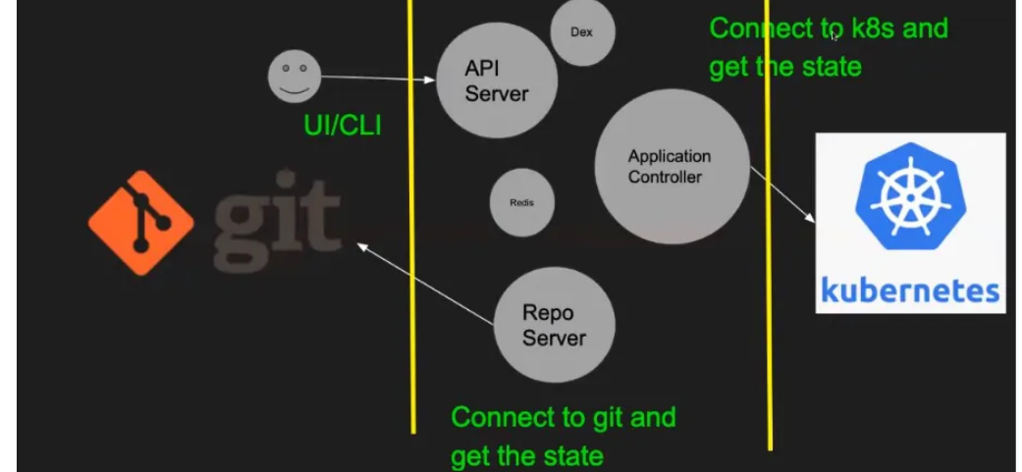
How Argo CD Works?

Slide 16

HOW ARGO CD WORKS?
API Server:
This component is used by the users to communicate to argo cd through UI or CLI and it also handles the authentication for the users.
Repository Server:
This component connects to git and fetch the state of the git repository.
Application Controller:
This component connects to kubernetes and fetch the state of the resources deployed in the kubernetes cluster.
CLI:
The CLI is a command-line tool that you can use to manage Argo CD. It allows you to create, update, and delete applications, synchronise with Git repositories, and monitor the state of your clusters.

Slide 17
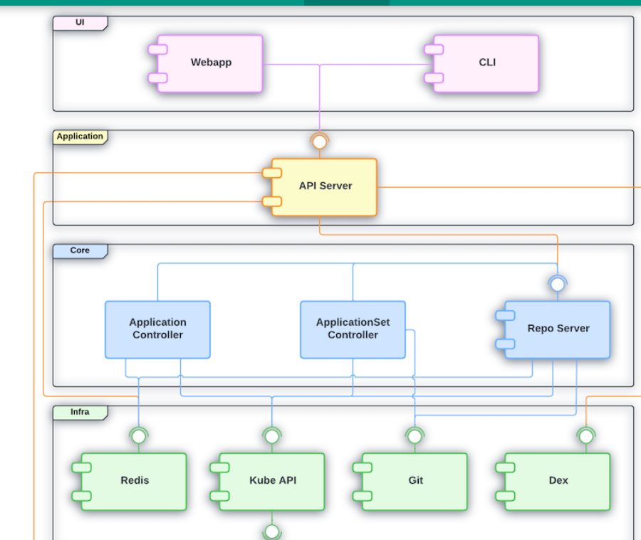
Architecture: Block Diagram

Slide 18


UI LAYER
What it is:
The user interface (UI) layer is the part of Argo CD that users interact with directly.
It includes the web dashboard and command-line interface (CLI).
What it does:
Users use the UI to manage applications, view application status, sync changes, and handle other tasks.

Slide 19
APPLICATION LAYER
What it is:
The application layer consists of the features and functionalities that support the UI layer.
What it does:
It handles requests from the UI, processes them, and returns the required information. This includes things like creating, updating, and deleting applications.

Slide 20
CORE LAYER
What it is:
The core layer is the heart of Argo CD, where the main GitOps functionality is implemented.
What it does:
This layer includes components and Kubernetes controllers that monitor and reconcile the state of applications based on the desired state defined in a Git repository. It ensures that the actual state matches the desired state.

Slide 21
INFRA LAYER
What it is:
The infrastructure (infra) layer consists of the external tools and services that Argo CD relies on.
What it does:
This includes Kubernetes itself, Git repositories, and other infrastructure components that Argo CD interacts with to perform its tasks. It provides the foundational services that Argo CD needs to operate.

Slide 22
CORE COMPONENTS
ArgoCD Server:
The central service that provides the ArgoCD API and serves the web UI. It acts as the command center, allowing users to interact with ArgoCD through a graphical interface or via the CLI.
Repository Service: Responsible for interfacing with Git repositories to fetch configuration data and monitor for changes. This service ensures that ArgoCD is always in sync with the desired state as defined in the Git repositories.

Slide 23
CORE COMPONENTS
Application Controller:
The heart of ArgoCD’s operation, the Application Controller continually monitors applications deployed in Kubernetes against the desired state stored in Git. If it detects any discrepancies, it initiates the synchronization process to correct them.
Dex Server:
An optional component that provides an identity federation service. Dex integrates with external identity providers (such as LDAP, SAML, GitHub, and others) to offer unified authentication and access control for ArgoCD.

Slide 24
CORE COMPONENTS
Redis DB :
Redis is used to manage and store the state of various ArgoCD components, ensuring that the system can quickly access and update application statuses and deployment data.
Cache:
Redis acts as a caching layer to store frequently accessed data, which reduces the load on the primary database and speeds up query responses. This helps in maintaining real-time synchronization between the desired state in Git and the actual state in Kubernetes clusters.

Slide 25
CORE FEATURES
Declarative Setup:
ArgoCD uses Git repositories as the source of truth for defining the desired application state in Kubernetes.
Self-Healing Deployments: ArgoCD continuously monitors deployed applications and heals them by automatically applying the desired state from Git, thus reducing downtime and manual intervention.
1
4
Automatic Sync:
It automatically syncs applications with their desired state in the Git repository, ensuring consistency and reliability.
Visual UI and CLI:
Offers a user-friendly UI and a powerful CLI, catering to different preferences for managing deployments.
2
3
Notes:
FM – FIXED MINDSET
GM – GROWTH MINDSET
FM - I’m too shy to speak in front of the class.
GM - I appreciate when people give me feedback.
FM - People who are naturally smart don’t need to try hard to succeed.
FM - Successful people are lucky/talented and have never experienced failure.
GM - I only truly fail when I stop trying.
FM - I wish I was as good at baseball as you. It’s not fair.
FM - I can’t do that!
GM - It is okay for me to ask help
FM - I’m just not good at reading
GM - There is always Plan B

Slide 26
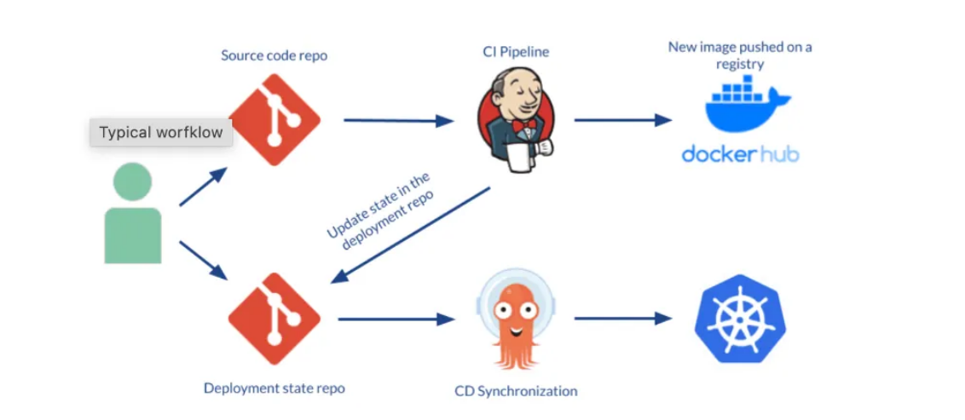
CD Workflow using Argo CD

Slide 27

CD WORKFLOW USING ARGO CD
A developer makes changes to an application, pushing a new version of Kubernetes resource definitions to a Git repo.
Continuous integration is triggered, resulting in a new container image saved to a registry.
A developer issues a pull request, changing Kubernetes manifests, which are created either manually or automatically.
The pull request is reviewed and changes are merged to the main branch. This triggers a webhook which tells Argo CD a change was made

Slide 28
CD WORKFLOW USING ARGO CD
Argo CD clones the repo and compares the application state with the current state of the Kubernetes cluster. It applies the required changes to cluster configuration.
Kubernetes uses its controllers to reconcile the changes required to cluster resources, until it achieves the desired configuration.
Argo CD monitors progress and when the Kubernetes cluster is ready, reports that the application is in sync.
ArgoCD also works in the other direction, monitoring changes in the Kubernetes cluster and discarding them if they don’t match the current configuration in Git.

Slide 29

Installation Of Argo CD
Explain the Lab setup of KIND
KIND→argoCD→github

Slide 30

Workshop Overview
What You'll Learn
Set up a local Kubernetes cluster using Kind
Install and configure ArgoCD for GitOps deployments
Access the ArgoCD web UI and manage applications
Understand continuous deployment with declarative configuration
Duration: 90 minutes | Difficulty: Beginner

Slide 31


Prerequisites & Tools
Required Software
Technical Requirements
Docker: Container runtime
kubectl: Kubernetes CLI (v1.35.0)
Kind: Kubernetes in Docker (v0.31.0)
Linux or WSL2 environment
4GB RAM minimum (8GB recommended)
10GB available disk space
Internet connection for downloads
Terminal access with sudo privileges

Slide 32
Step 1: Docker Setup
Install Docker Engine
# Update system and add Docker repository
sudo apt update
sudo apt install ca-certificates curl
# Add Docker GPG key
sudo curl -fsSL https://download.docker.com/linux/ubuntu/gpg \
-o /etc/apt/keyrings/docker.asc
# Install Docker packages
sudo apt install docker-ce docker-ce-cli containerd.io

Slide 33
Step 2: Install Kind & kubectl
Kind (Kubernetes in Docker) enables running a full Kubernetes cluster in Docker containers
# Install kubectl (Kubernetes CLI)
curl -LO https://dl.k8s.io/release/v1.35.0/bin/linux/amd64/kubectl
sudo install -o root -g root -m 0755 kubectl /usr/local/bin/kubectl
kubectl version
# Install Kind
curl -Lo ./kind https://kind.sigs.k8s.io/dl/v0.31.0/kind-linux-amd64
chmod +x ./kind
sudo mv ./kind /usr/local/bin/kind

Slide 34
Step 3: Create Kind Cluster
Create Cluster
Verify Cluster
kind create cluster --name argocd-workshop
kubectl cluster-info
kubectl get nodes
Set Context
Ensure kubectl is pointing to the correct cluster context:
kubectl config use-context kind-argocd-workshop
kubectl config current-context

Slide 35
Step 4: Install ArgoCD
ArgoCD will be installed in its own namespace using the official manifest
# Create ArgoCD namespace
kubectl create namespace argocd
# Install ArgoCD
kubectl apply -n argocd -f \
https://raw.githubusercontent.com/argoproj/argo-cd/stable/manifests/install.yaml
# Wait for all pods to be running
kubectl wait --for=condition=ready pod --all -n argocd --timeout=300s

Slide 36

Step 5: Access ArgoCD UI
Port Forward
Retrieve Password
kubectl port-forward svc/argocd-server \
-n argocd 8080:443
kubectl -n argocd get secret \
argocd-initial-admin-secret \
-o jsonpath="{.data.password}" | \
base64 -d
Leave terminal running, open
new terminal for next steps
Username: admin
Password: (decoded output)
Open browser: https://localhost:8080

Slide 37
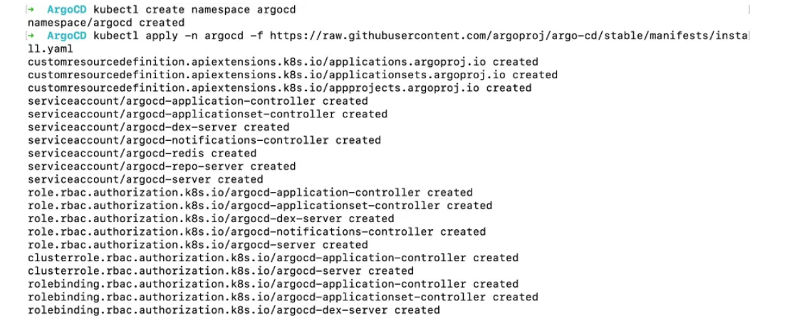
INSTALLATION
$kubectl create namespace argocd
$ kubectl apply -n argocd -f https://raw.githubusercontent.com/argoproj/argo-cd/stable/manifests/install.yaml

Slide 38
INSTALLATION
$kubectl create namespace argocd
$ kubectl apply -n argocd -f https://raw.githubusercontent.com/argoproj/argo-cd/stable/manifests/install.yaml

Slide 39
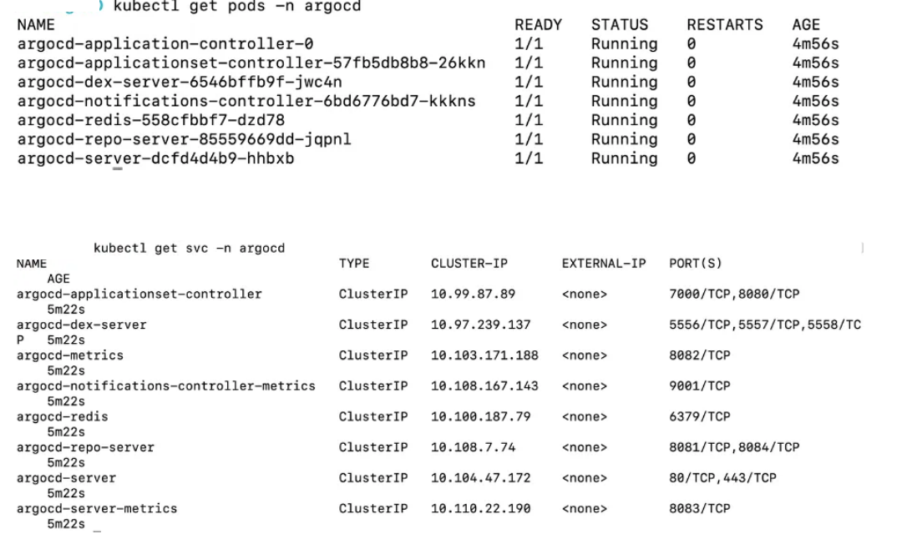
INSTALLATION

Slide 40
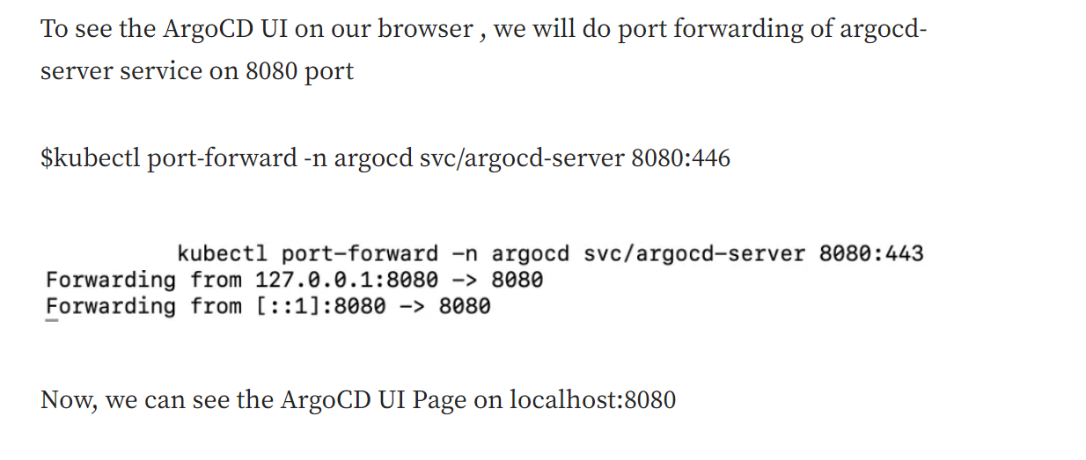
INSTALLATION

Slide 41
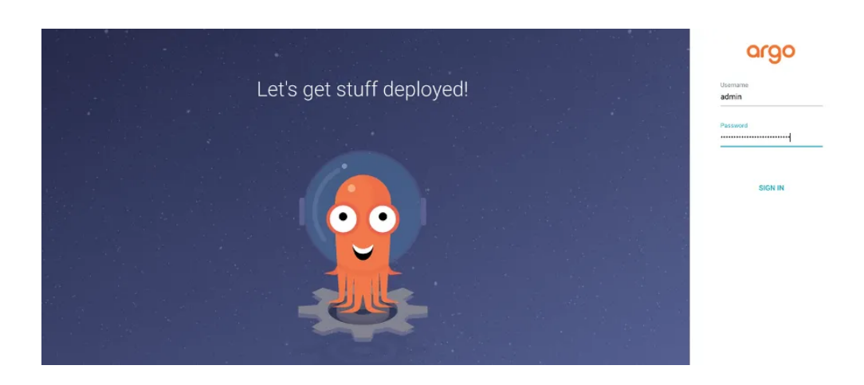
ARGO UI

Slide 42
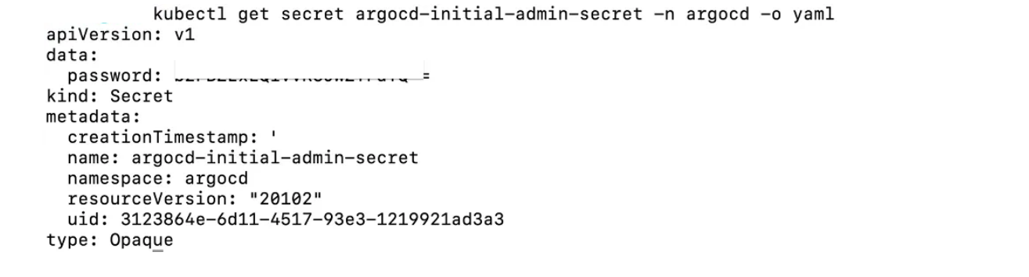
INITIAL PASSWORD
The initial password for the admin account is auto-generated and stored as clear text in the field password in a secret named argocd-initial-admin-secret in your Argo CD installation namespace. You can simply retrieve this password using
$ kubectl -n argocd get secret argocd-initial-admin-secret -o jsonpath=”{.data.password}” | base64 -d; echo

Slide 43
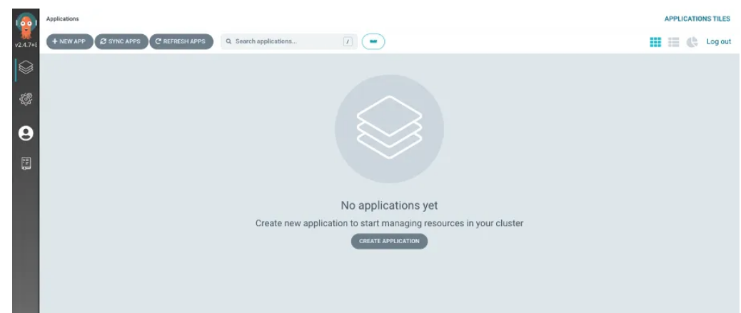
INITIAL PASSWORD

Slide 44
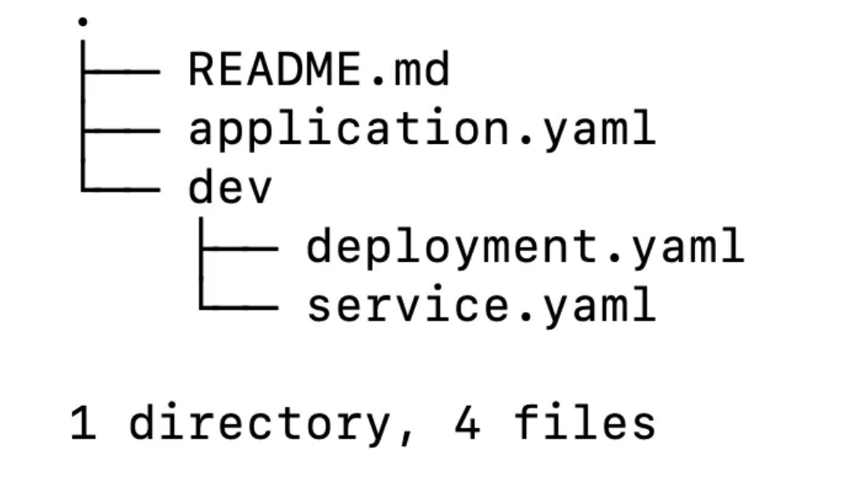
WORKFLOW OF ARGOCD

Slide 45
WORKFLOW OF ARGOCD
This is the directory structure which we are following where a folder (dev) is containing all the manifest yaml files and an application.yaml file which is the Kubernetes resource object representing a deployed application instance in an environment.
It has 2 fields where “source” references the desired state in Git and “destination” references to the target cluster and namespace.

Slide 46
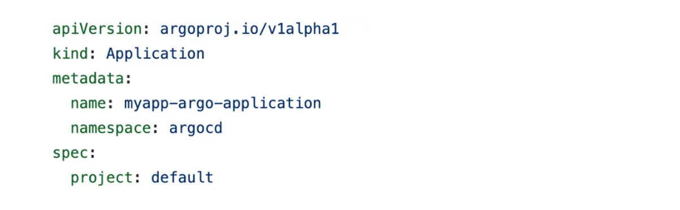
CRD: KIND

Slide 47
Explanation
This is the application CRD where kind is “Application” and namespace is “argocd” which tells that in the application that we are creating should be in argocd namespace where the argocd pods (controller , server ….etc) are running .
The project field is “default” à Every application belong to a single project ( If not specified , it will assume it as default )

Slide 48
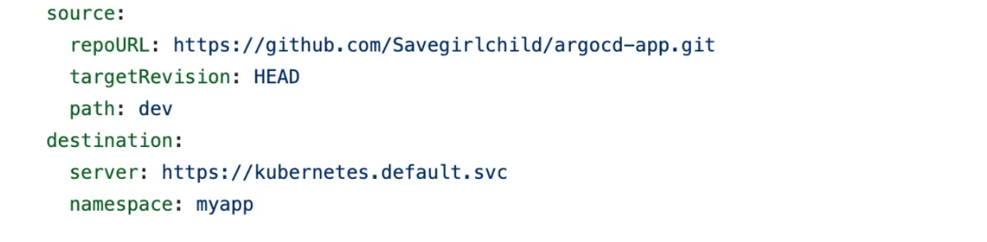
SOURCE FIELD

Slide 49
EXPLANATION
The source field references the Git Repository where all the manifest files will be uploaded, repoUrl
Put the url of the Git Repository and targetRevision = HEAD .It takes the last commit in the repository , path = Dev which path in Git ,you want to sync your cluster with

Slide 50
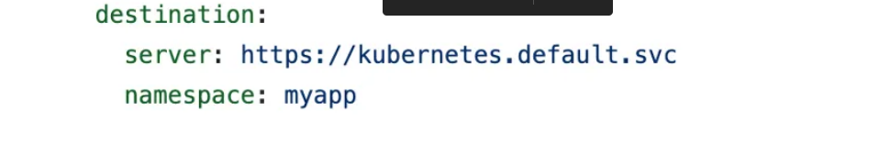
DESTINATION FIELD
The destination field references the target cluster. In this we have a field as “server” Specifies the endpoint of the Kubernetes API Server and “namespace” Specifies which namespace you want your argocd to deploy your application to.

Slide 51
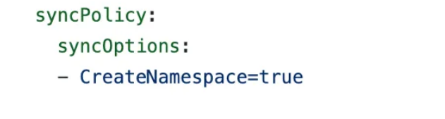
SYNC POLICY
The syncPolicy field -How to sync the desired state in the target cluster. Here , the field “CreateNamespace=True” ensures that the namespace specified exists in the destination and if not then it will create namespace

Slide 52
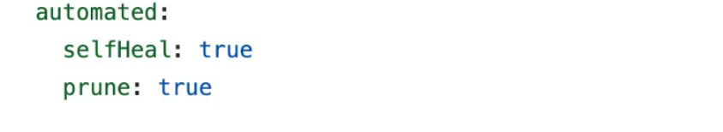
SELF HEAL
The automated “selfHeal=true” field
Cluster automatically sync with Git by ArgoCD which by default is set to off. “prune=true”
Automatically delete the component in Kubernetes cluster if your yaml files(CRD) are deleted from Git Repository.

Slide 53
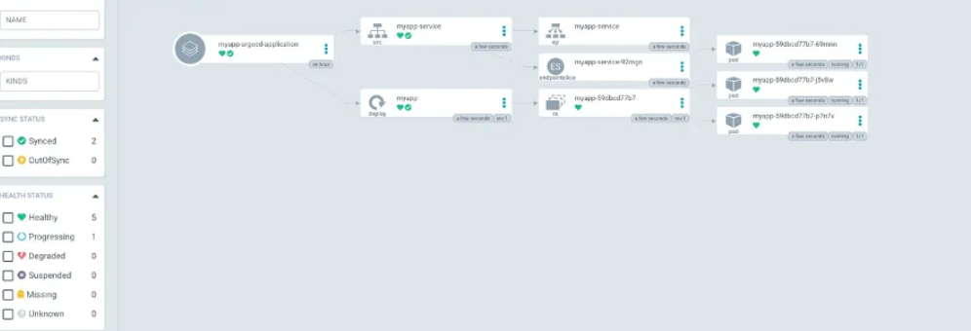
SELF HEAL

Slide 54
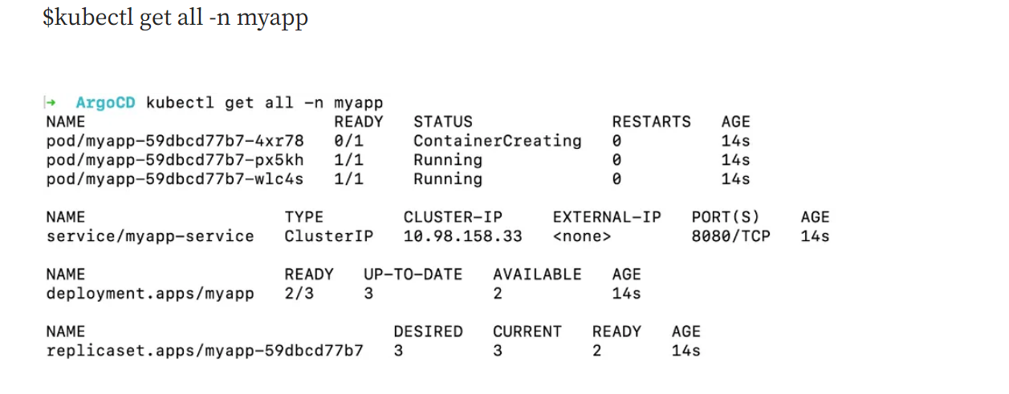
SELF HEAL

Slide 55

LABS

Slide 56

FEEDBACK

Slide 57

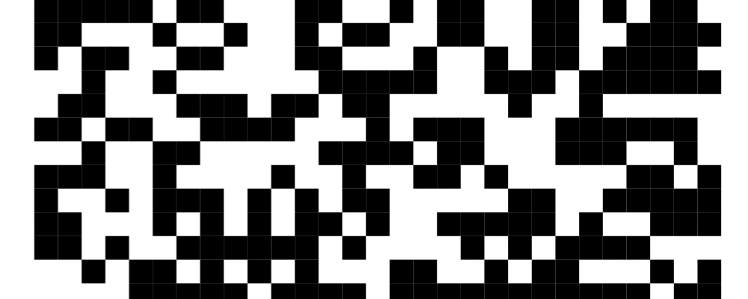

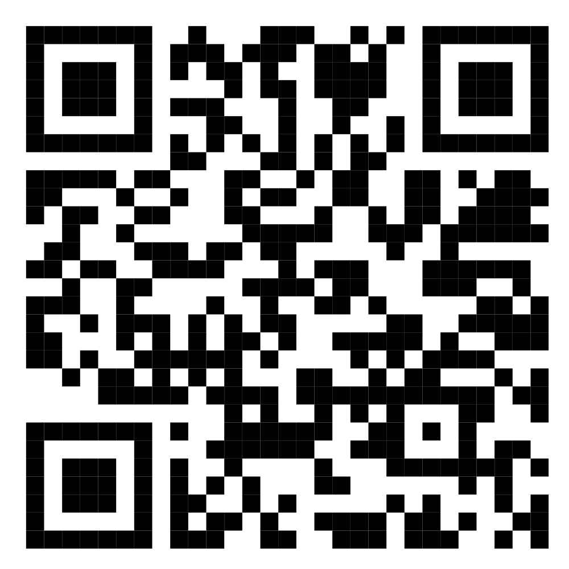

Scan Now and Follow
Imarticus Corporate Solutions: LinkedIn
https://www.linkedin.com/company/contact-imarticus-learning/
We’re committed to empower you to be
#FutureReady
through powerful training solutions.
We build the workforce of the future.
625+
Corporate Clients
1,10,000+
Learners Trained
50,000+
Hours of Training
Contact us today!
https://imarticus.org/corporate/training-solution/
Enroll Now!

